Slide 1


React JS

Slide 2

What is React ?
Developed by Facebook in 2013. (Jordan Walke)
A JavaScript library for building User Interfaces.

Slide 3
Why React ?

Slide 4
Angular vs React vs Vue
ANGULAR | REACT | VUE
Framework | Library | Library
Developed by Google | Developed by Facebook | Open-Source Project
Typescript | JSX | HTML & JavaScript
Develop Native, Hybrid & Web apps | Develop SPA & Mobile Apps | Develop SPA & Native Apps
MVC architecture | Virtual DOM | Virtual DOM

Slide 5
Features of React JS
Based on component structure
Uses JSX ( Extension of JavaScript )
Best used for SPA (Single Page Applications)
Utilises both Virtual DOM and Real DOM

Slide 6

Environment Setup
Step 1 : Install Node.js
Step 2 : npm install -g create-react-app
Step 3 : npx create-react-app <app_name>

Slide 7
Document Object Model
Nav Bar
Courses
DSA
FSD
Profile
Signup

Slide 8
Virtual DOM
Virtual
DOM
State Change
Compute Diff
Re-render
Browser
DOM
Notes:
The changes which we make in component, these changes will be combined and create a new Virtual DOM.
Virtual DOM will be compared with the Real DOM.
Then it will only replace where change has occurred.
This process increases the efficiency of the application.

Slide 9
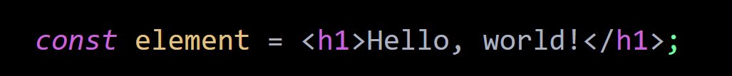
JavaScript Executable ( JSX )
Syntax Extension to JavaScript.
Produces React “elements”.
Notes:
it is a syntax extension to JavaScript. We recommend using it with React to describe what the UI should look like.
JSX produces React “elements”.
React embraces the fact that rendering logic is inherently coupled with other UI logic: how events are handled, how the state changes over time, and how the data is prepared for display.

Slide 10
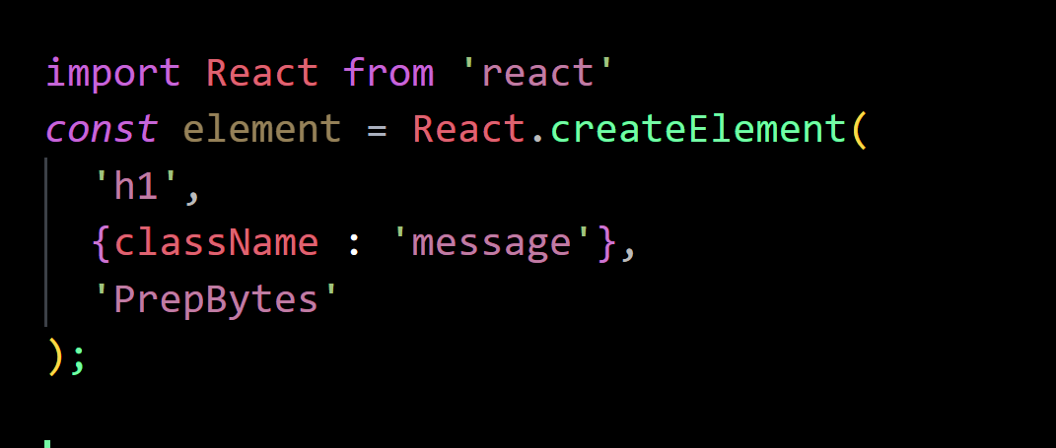
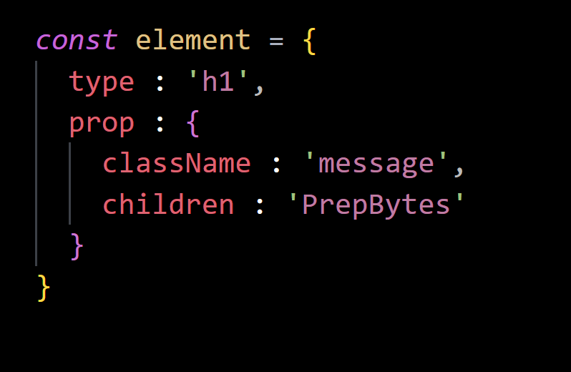
React without JSX
createElement() definition
Representation of Object Created

Slide 11
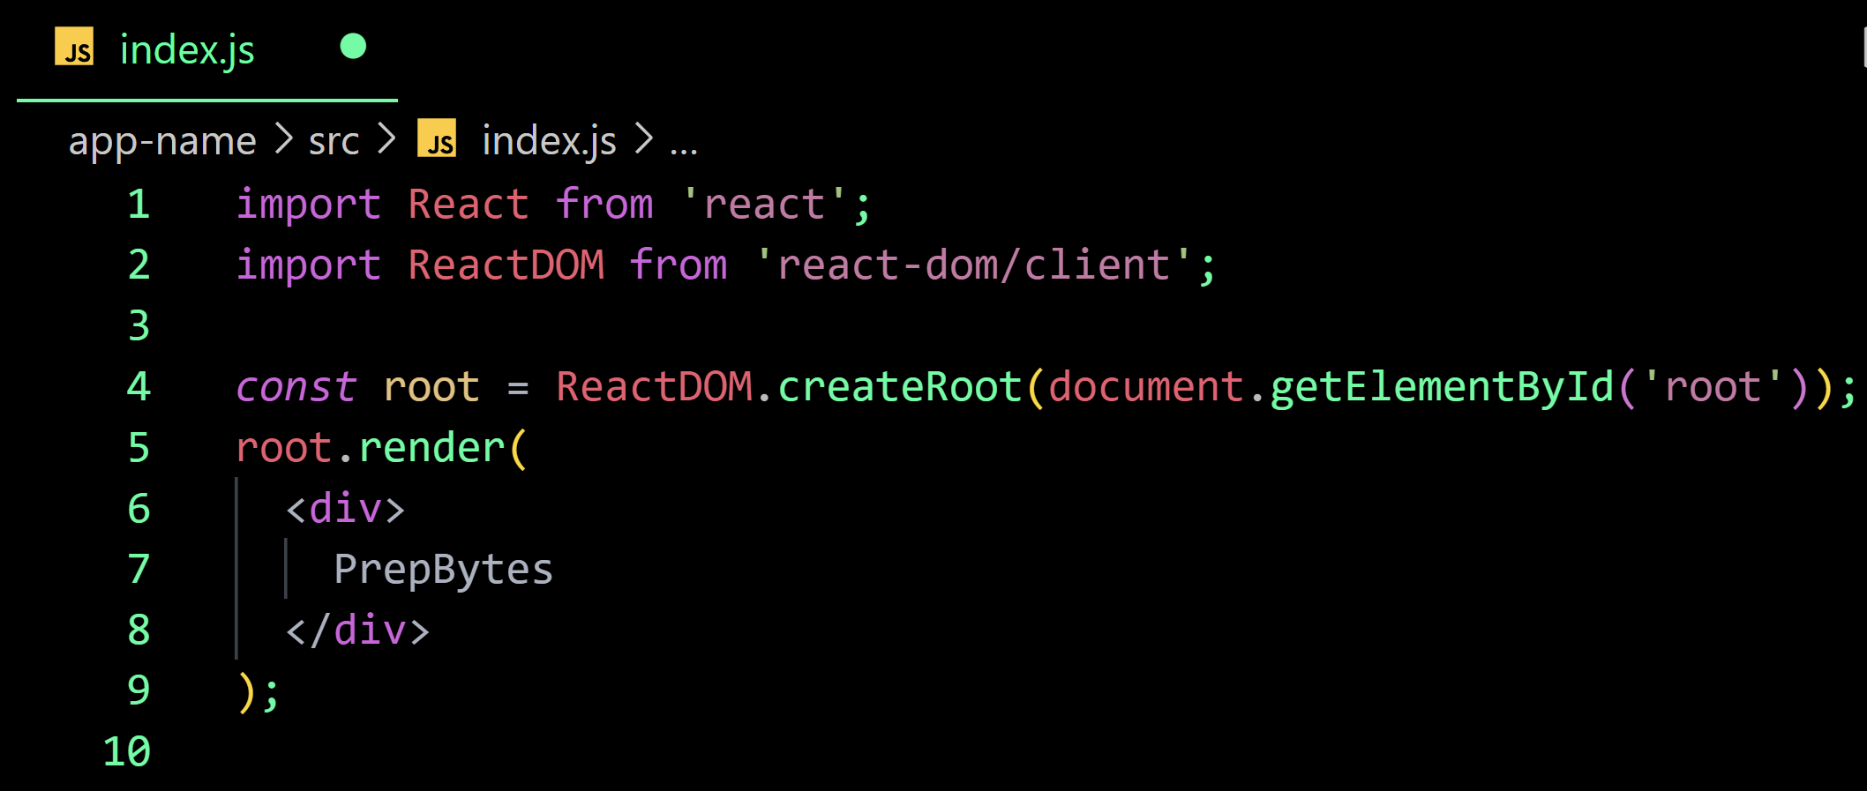
React with JSX

Slide 12


JavaScript Executable ( JSX )
JSX can be used for
Embedding Expression
Specifying Attributes
Represent Objects
And many more tasks…..
Notes:
Babel compiles JSX down to React.createElement() calls.
React.createElement() performs a few checks to help you write bug-free code but essentially it creates an object like this:
These objects are called “React elements”. You can think of them as descriptions of what you want to see on the screen. React reads these objects and uses them to construct the DOM and keep it up to date.

Slide 13
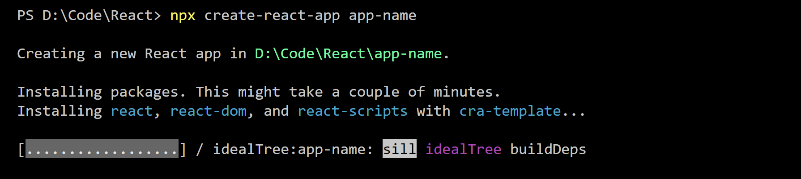
create-react-app
Less to Learn
Only one dependency
No lock in
Notes:
Less to Learn
You don't need to learn and configure many build tools. Instant reloads help you focus on development. When it's time to deploy, your bundles are optimized automatically.
Only One Dependency
Your app only needs one build dependency. We test Create React App to make sure that all of its underlying pieces work together seamlessly – no complicated version mismatches.
No Lock-In
Under the hood, we use webpack, Babel, ESLint, and other amazing projects to power your app. If you ever want an advanced configuration, you can ”eject” from Create React App and edit their config files directly.

Slide 14
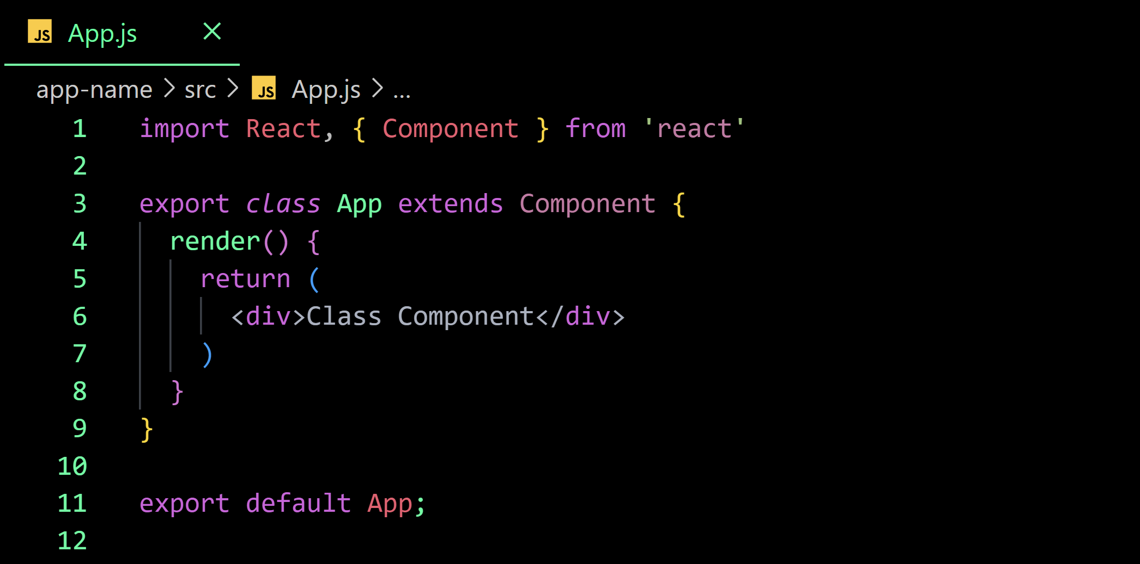
Ways to Create Components
Class Components

Slide 15
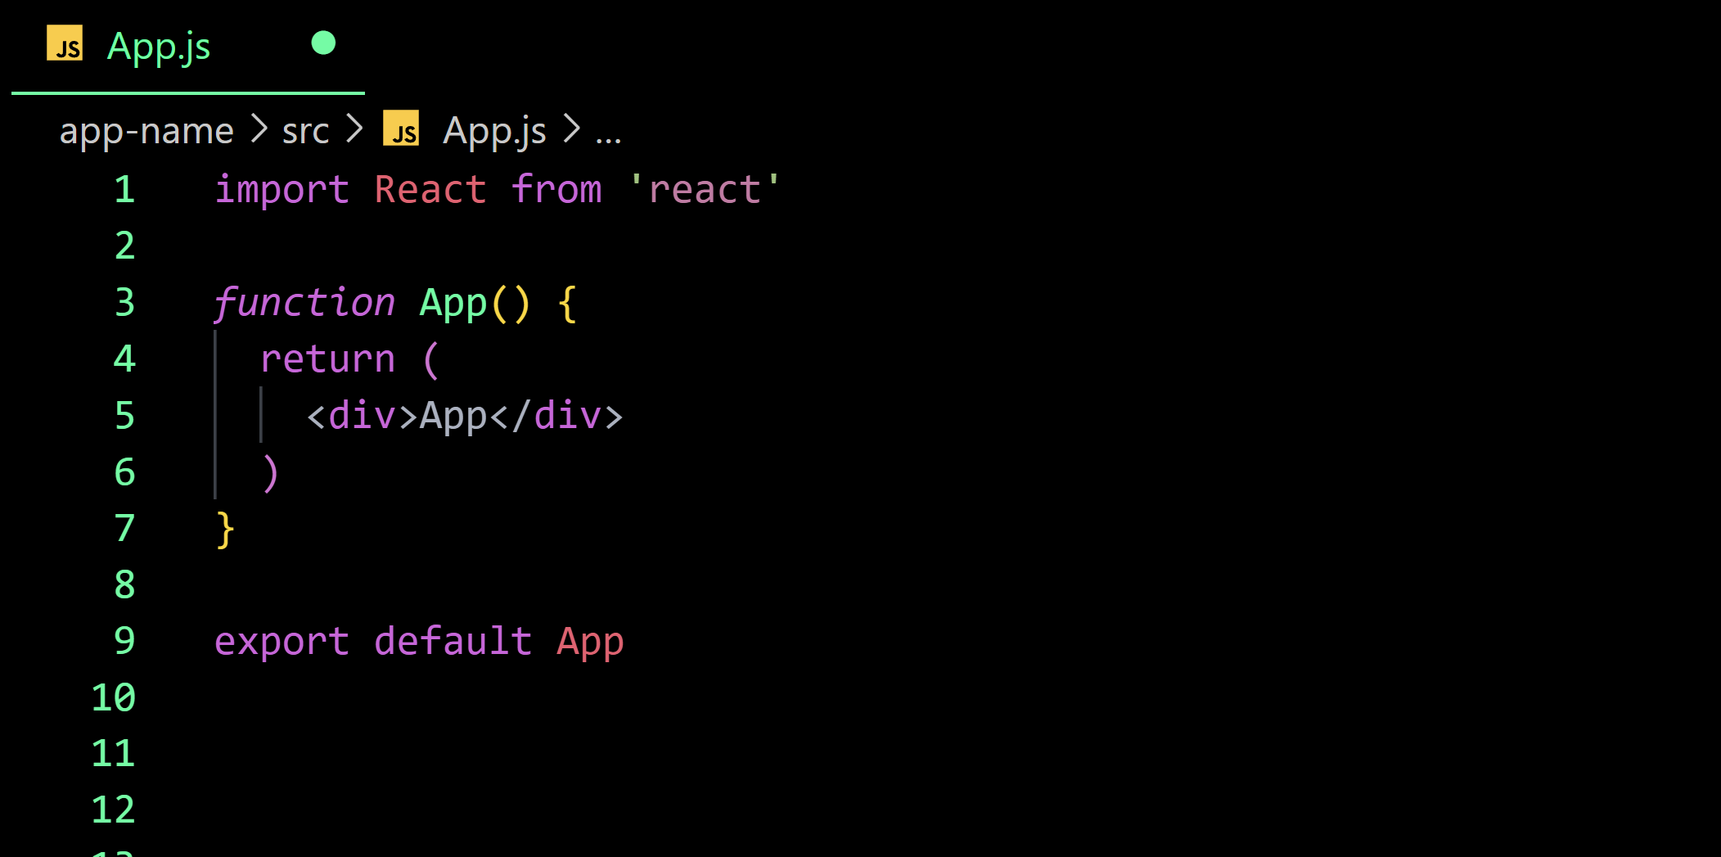
Ways to Create Components
Function Components

Slide 16
Functional vs Class Components
Functional Components
Pure JavaScript function
No render Method
Stateless Components
React Lifecycle methods cannot be used
Class Components
Class that extends properties from React.Component
render() method is mandatory
Stateful Component
React lifecycle methods can be used

Slide 17
Functional vs Class Components
Functional Components
Hooks can be easily used
No State Variables
Class Components
Hooks can be used with different syntax
Contains State Variables

Slide 18
Props
Arguments passed into React Components
React is pretty flexible but it has a single strict rule:
“All React components must act like pure functions with respect to their props.”
Pure Functions don’t attempt to change their inputs , i.e. they are immutable
Notes:
Props are arguments passed into React components.
Props are passed to components via HTML attributes.
props stands for properties.

Slide 19
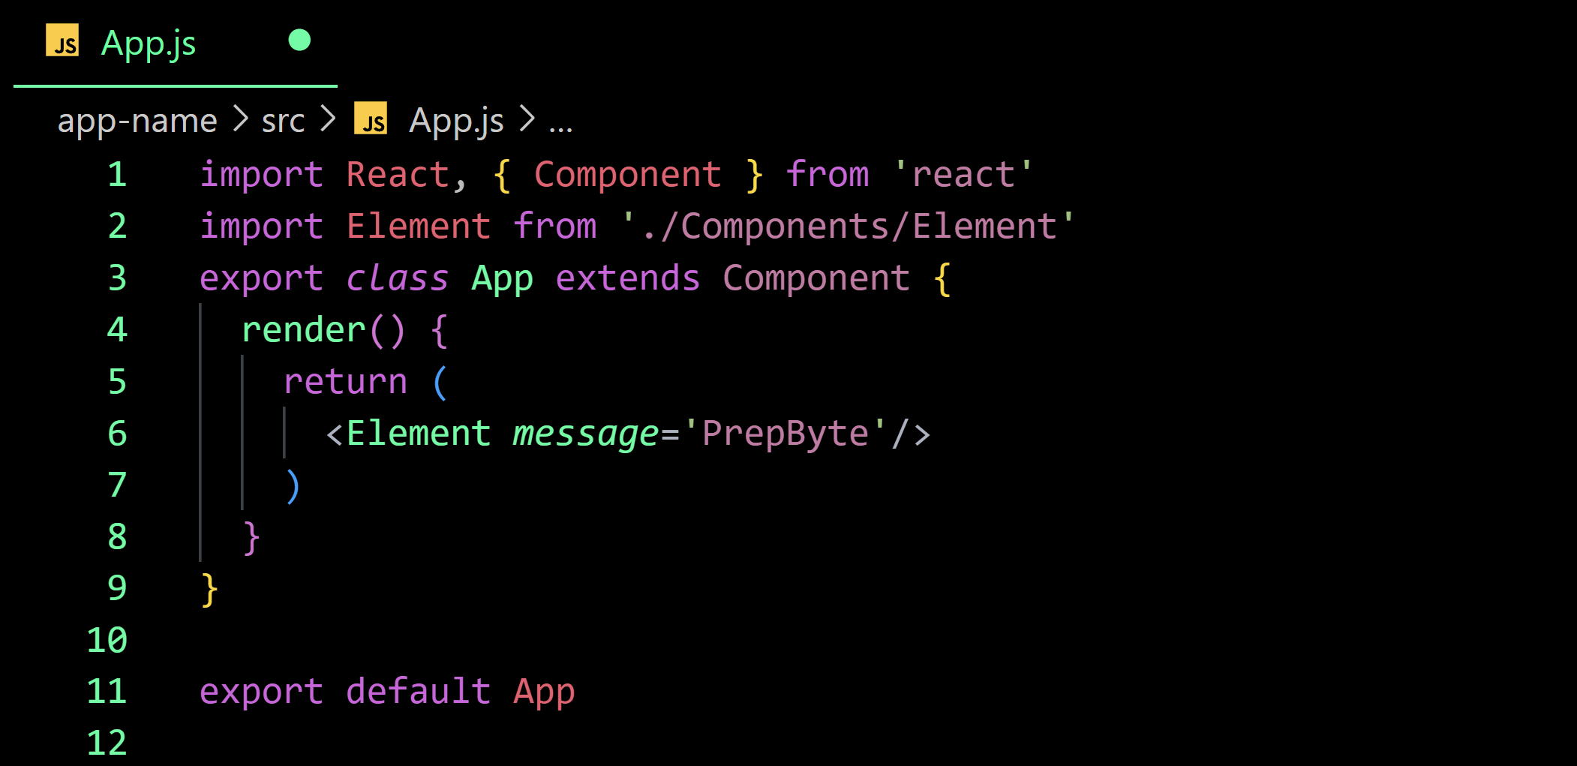
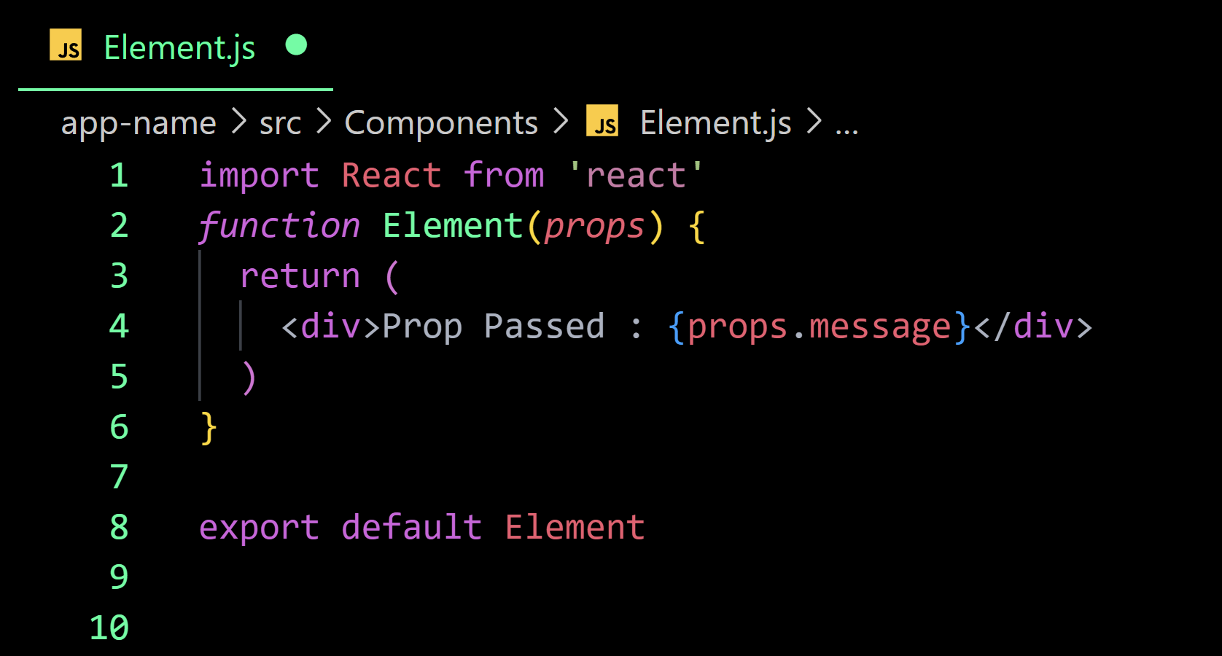
Props
Notes:
Props are arguments passed into React components.
Props are passed to components via HTML attributes.
props stands for properties.

Slide 20
State
Build-in React Object
Used to contain data or information about component
State can change over time
On change of state , the component re-renders
A state can be modified based on user action or network changes
this.setState() is used to change the value of the state object

Slide 21
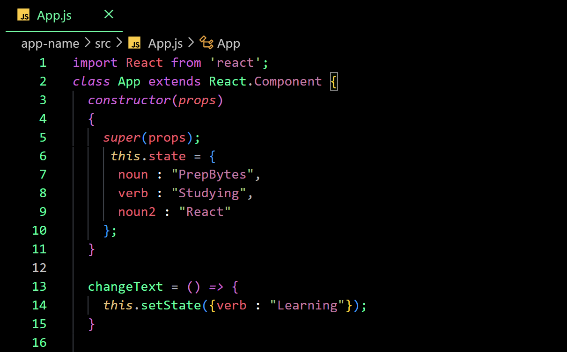
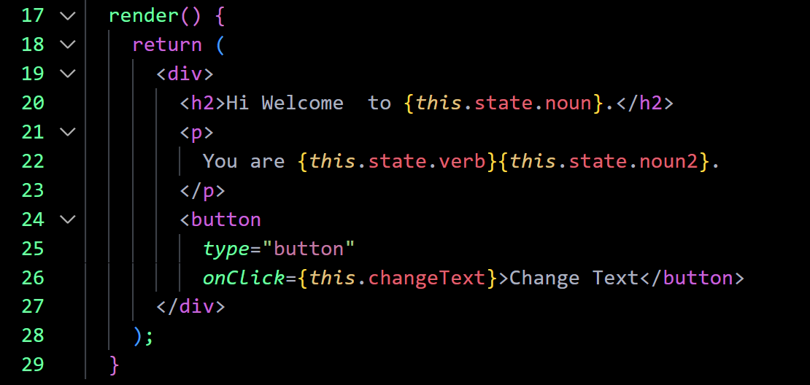
setState()

Slide 22
Props Vs State
 | State | Props
Use Case | State is used to store the data of the components that have to be rendered to the view | Props are used to pass data and event handlers to the children components
Mutability | State holds the data and can change over time | Props are immutable—once set, props cannot be changed
Component | State can only be used in class components | Props can be used in both functional and class components
Updation | Event handlers generally update state | The parent component sets props for the children components

Slide 23
Event Listeners
Functions that listen for some events happening and execute when that event happens.
React events are usually written in camelCase
React event handlers are written inside of curly braces.
Arguments are passed to event handlers using an arrow function
Notes:
Props are arguments passed into React components.
Props are passed to components via HTML attributes.
props stands for properties.

Slide 24
React Context API
App
App
Users
Users
User info
User info
Without Context API
With Context API
Notes:
https://reactjs.org/docs/context.html

Slide 25
React Context API
React.createContext()
Context.Provider
Class.contextType
Context.Consumer
Context.displayName
Notes:
https://reactjs.org/docs/context.html

Slide 26
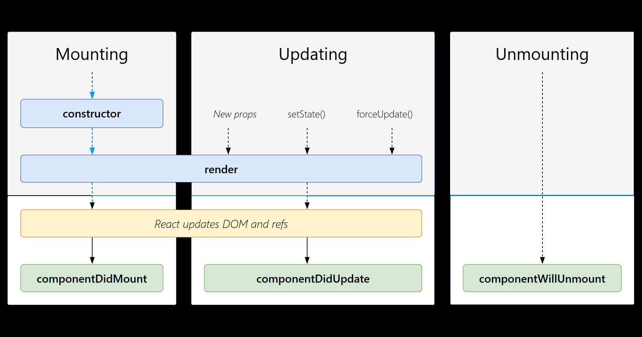
React Life Cycle
Notes:
https://reactjs.org/docs/context.html

Slide 27
Conditional Rendering
Rendering the components in react can be conditional.
There are many ways to achieve this as :
Logical && Operator
If-else
Ternary Operator
Switch-case
Notes:
https://reactjs.org/docs/context.html

Slide 28
High Order Components
HOC is a function which takes a Wrapped component as input argument and returns a new Enhanced component
It should always be a pure function.
It should never modify the Wrapped Component.
Notes:
https://reactjs.org/docs/context.html

Slide 29
Pure Components
Component is Pure if
Return value is only determined by it’s input values
It’s return value is always the same for the same input values
Class components that extend the React.PureComponent class are treated as pure components

Slide 30
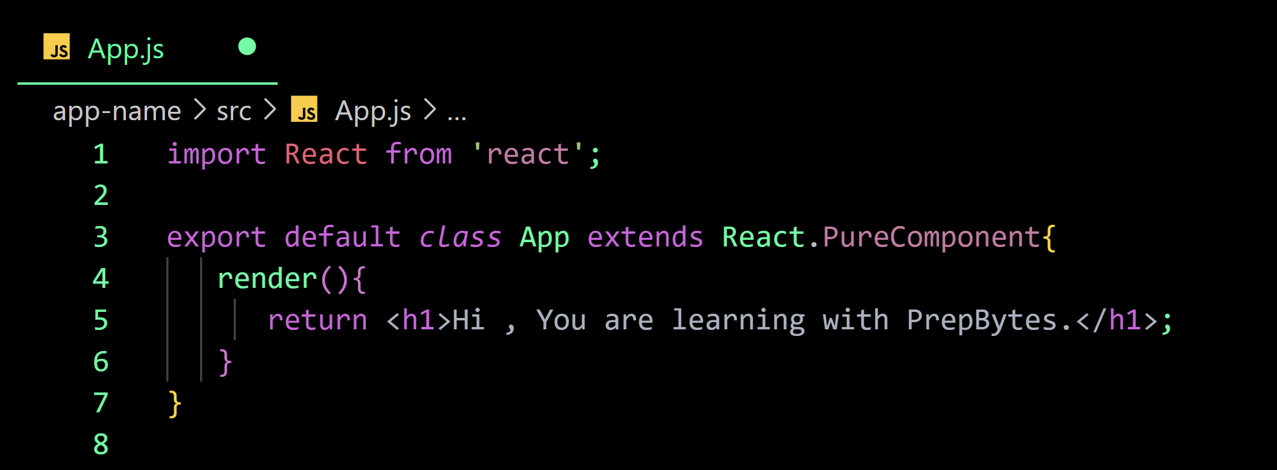
Pure Components

Slide 31
Pure Components
Pure Components prevents components being re-rendered if the values of state and props has not changed.
These components will be rendered only in 3 conditions:
this.setState({ })
Change in props
this.forceUpdate( )
Exception : shouldComponentUpdate
Notes:
The components are the ones which prevents being re-rendered if the values of state and props has not changed.
Exception : shouldComponentUpdate, a lifecycle method which does not gets called in all the components but this method will be called in these components to compare the state and props values.

Slide 32
React Forms
Controlled Components
Uncontrolled Components
Notes:
https://reactjs.org/docs/forms.html

Slide 33
Form Elements
The input Tag
The textarea Tag
The select Tag
The file input Tag

Slide 34
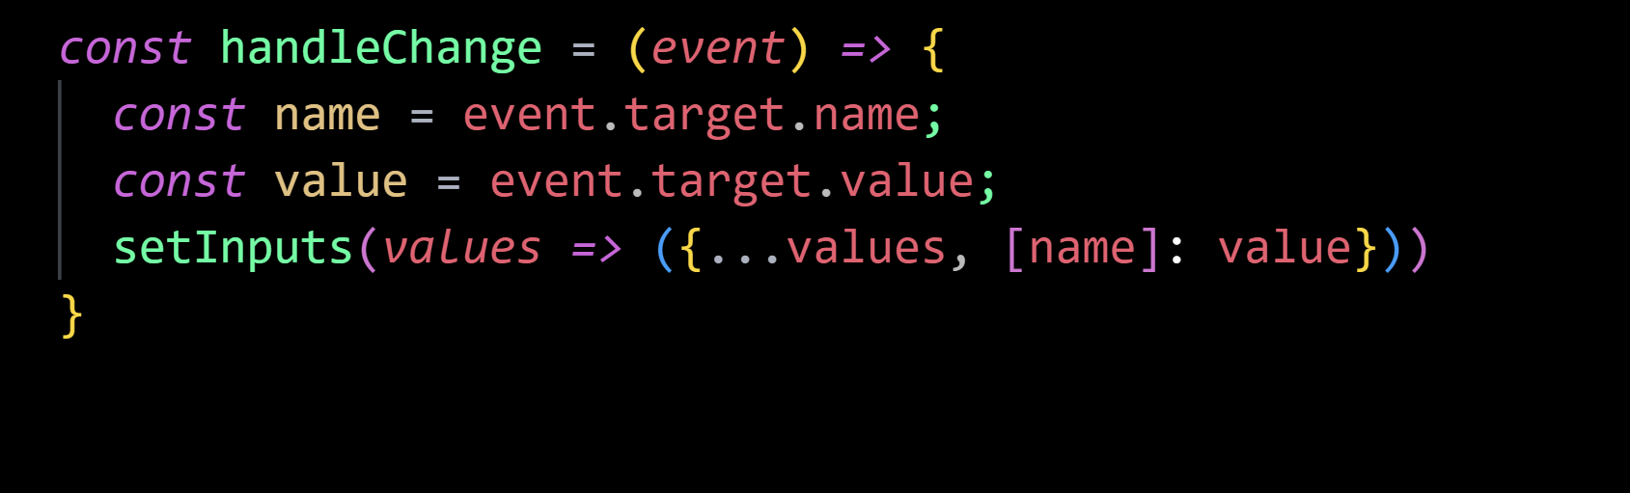
Handling Multiple Inputs
Multiple inputs are handled by using name Attribute
To access the fields in the event handler use the event.target.name and event.target.value syntax.

Slide 35


React Router
Multi page Application
Single page Application

Slide 36
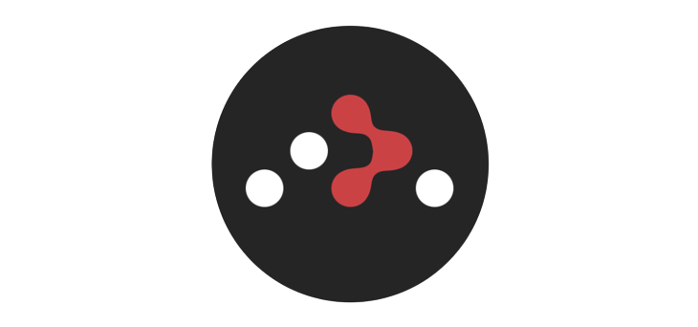

React Router
react-router-dom
react-router-native

Slide 37
React Router
Types of Routers
BrowserRouter
HashRouter
MemoryRouter
NativeRouter
StaticRouter

Slide 38
React Router
Data Routers
createBrowserRouter
createMemoryRouter
createHashRouter
Notes:
(Newly Added) https://reactrouter.com/en/main/routers/picking-a-router

Slide 39
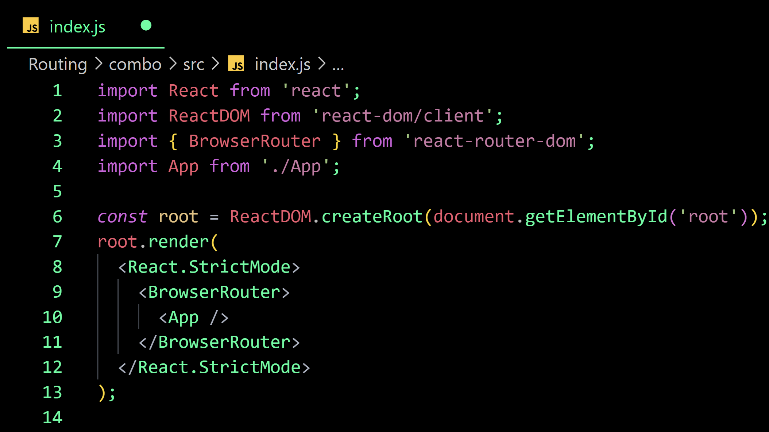
Implementing Routing
Step 1 : Wrap Component with a Router

Slide 40
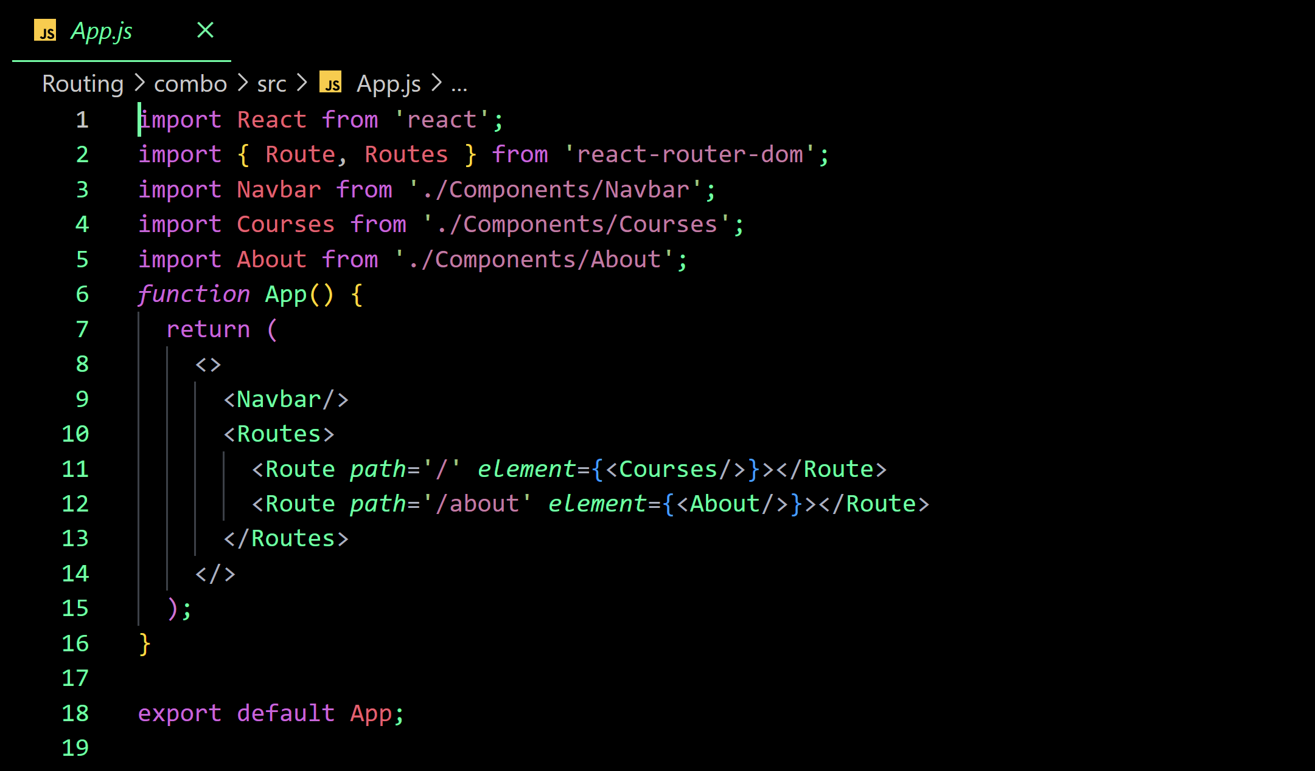
Implementing Routing
Step 2 : Set-up Routes and Route.

Slide 41
React Router
Components
Link
NavLink
Navigate
Outlet
Notes:
(Newly Added) https://reactrouter.com/en/main/routers/picking-a-router

Slide 42
React Router
More on Routing
Dynamic Segment
Splat / MatchAll
Routing Priority
Nesting Routes
Notes:
(Newly Added) https://reactrouter.com/en/main/routers/picking-a-router

Slide 43
React Router
Hooks
useRoutes
useParams
useHistory
useLocation
useOutlet
useOutletContext
Notes:
(Newly Added) https://reactrouter.com/en/main/routers/picking-a-router

Slide 44
React Hooks
Allows use of state and other features in Functional Components
Hooks are functions that let you “hook into” React state and lifecycle features from function components
Types of Hooks
- State Hook
- Effect Hook
- Context Hook
Notes:
(Newly Added) https://reactrouter.com/en/main/routers/picking-a-router

Slide 45
State Hook
useState()
[currStateValue,updatefunction]
Notes:
React will preserve this state between re-renders. useState returns a pair: the current state value and a function that lets you update it. You can call this function from an event handler or somewhere else. It’s similar to this.setState in a class, except it doesn’t merge the old and new state together.

Slide 46
State Hook
Problem Statement : Create A Counter App using useState()
Notes:
React will preserve this state between re-renders. useState returns a pair: the current state value and a function that lets you update it. You can call this function from an event handler or somewhere else. It’s similar to this.setState in a class, except it doesn’t merge the old and new state together.

Slide 47
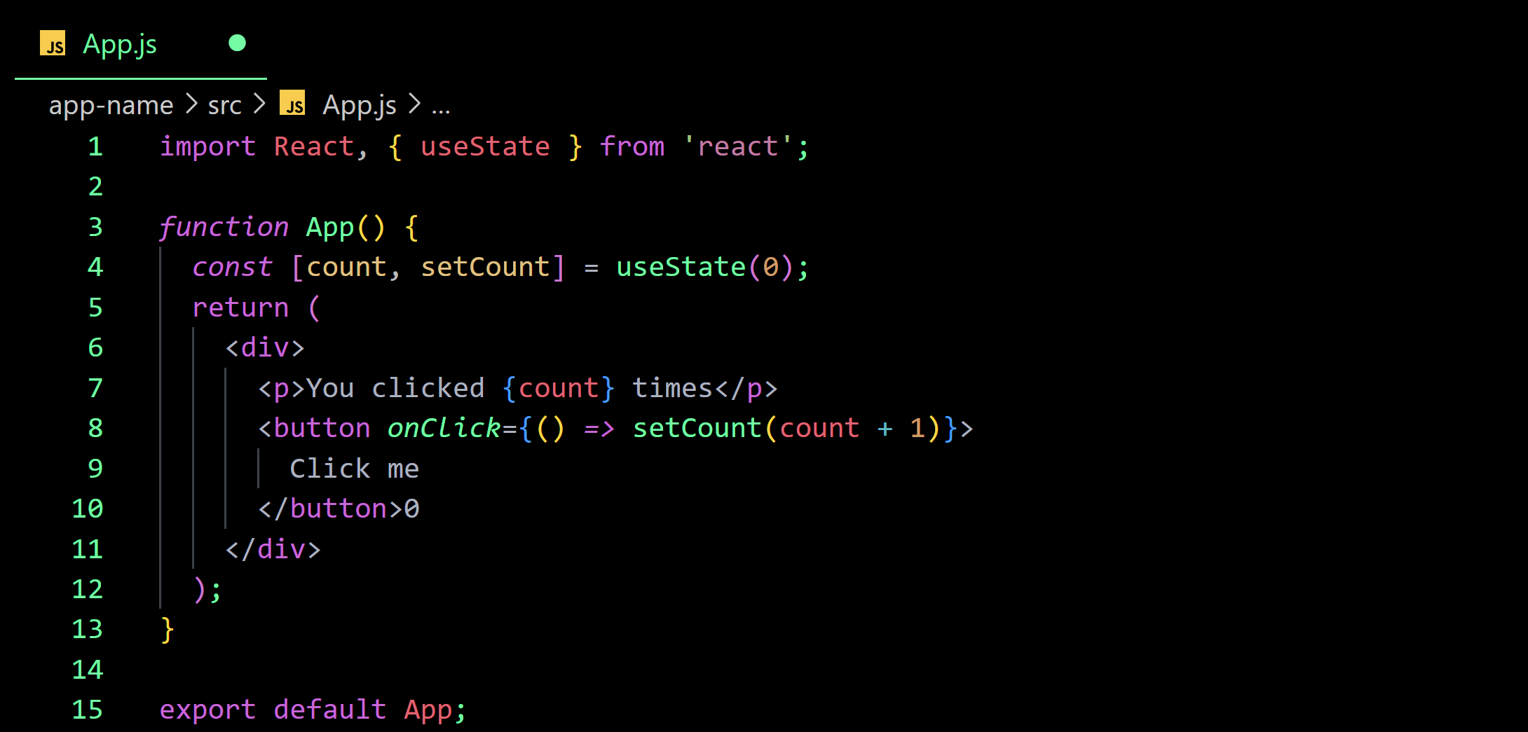
useState() Hook
Notes:
React will preserve this state between re-renders. useState returns a pair: the current state value and a function that lets you update it. You can call this function from an event handler or somewhere else. It’s similar to this.setState in a class, except it doesn’t merge the old and new state together.

Slide 48
Effect Hook
Adds the ability to perform side effects from a function component
These Side effects can be
- Data Fetching
- Subscriptions
- Manually Changing DOM , etc.
Serves the same purpose as componentDidMount, componentDidUpdate and componentWillUnMount.
Notes:
React will preserve this state between re-renders. useState returns a pair: the current state value and a function that lets you update it. You can call this function from an event handler or somewhere else. It’s similar to this.setState in a class, except it doesn’t merge the old and new state together.

Slide 49
Effect Hook
Problem Statement : Update Document title using useEffect() on the Counter App.
Notes:
React will preserve this state between re-renders. useState returns a pair: the current state value and a function that lets you update it. You can call this function from an event handler or somewhere else. It’s similar to this.setState in a class, except it doesn’t merge the old and new state together.

Slide 50
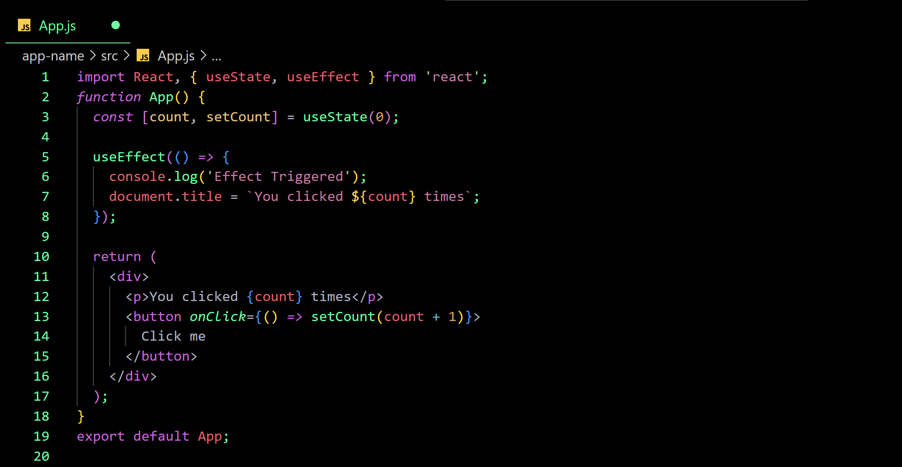
Effect Hook
Notes:
React will preserve this state between re-renders. useState returns a pair: the current state value and a function that lets you update it. You can call this function from an event handler or somewhere else. It’s similar to this.setState in a class, except it doesn’t merge the old and new state together.

Slide 51
Context Hook
Accepts a context object and returns the current context value for that context
When the nearest <MyContext.Provider> above the component updates, this Hook will trigger a re-render with the latest context value passed to that MyContext provider.
A component calling useContext will always re-render when the context value changes.
Notes:
React will preserve this state between re-renders. useState returns a pair: the current state value and a function that lets you update it. You can call this function from an event handler or somewhere else. It’s similar to this.setState in a class, except it doesn’t merge the old and new state together.

Slide 52

Context Hook
Problem Statement : Change Theme of a Button element called ThemedButton on change of context value. The button is a Child component of a component called SignUp and SignUp is a Child component of App Component.
Notes:
React will preserve this state between re-renders. useState returns a pair: the current state value and a function that lets you update it. You can call this function from an event handler or somewhere else. It’s similar to this.setState in a class, except it doesn’t merge the old and new state together.

Slide 53
Redux
Pattern/Library for managing and updating application state, using events
called ‘actions’ .
Helps manage ‘GLOBAL’ state
Notes:
Redux is a pattern and library for managing and updating application state, using events called "actions". It serves as a centralized store for state that needs to be used across your entire application, with rules ensuring that the state can only be updated in a predictable fashion.
Redux helps you manage "global" state - state that is needed across many parts of your application.
The patterns and tools provided by Redux make it easier to understand when, where, why, and how the state in your application is being updated, and how your application logic will behave when those changes occur. Redux guides you towards writing code that is predictable and testable, which helps give you confidence that your application will work as expected.

Slide 54
When to use Redux
You have large amounts of application state that are needed in many places in the app
The app state is updated frequently over time
The logic to update that state may be complex
The app has a medium or large-sized codebase, and might be worked on by many people
Notes:
Redux is a pattern and library for managing and updating application state, using events called "actions". It serves as a centralized store for state that needs to be used across your entire application, with rules ensuring that the state can only be updated in a predictable fashion.
Redux helps you manage "global" state - state that is needed across many parts of your application.
The patterns and tools provided by Redux make it easier to understand when, where, why, and how the state in your application is being updated, and how your application logic will behave when those changes occur. Redux guides you towards writing code that is predictable and testable, which helps give you confidence that your application will work as expected.

Slide 55
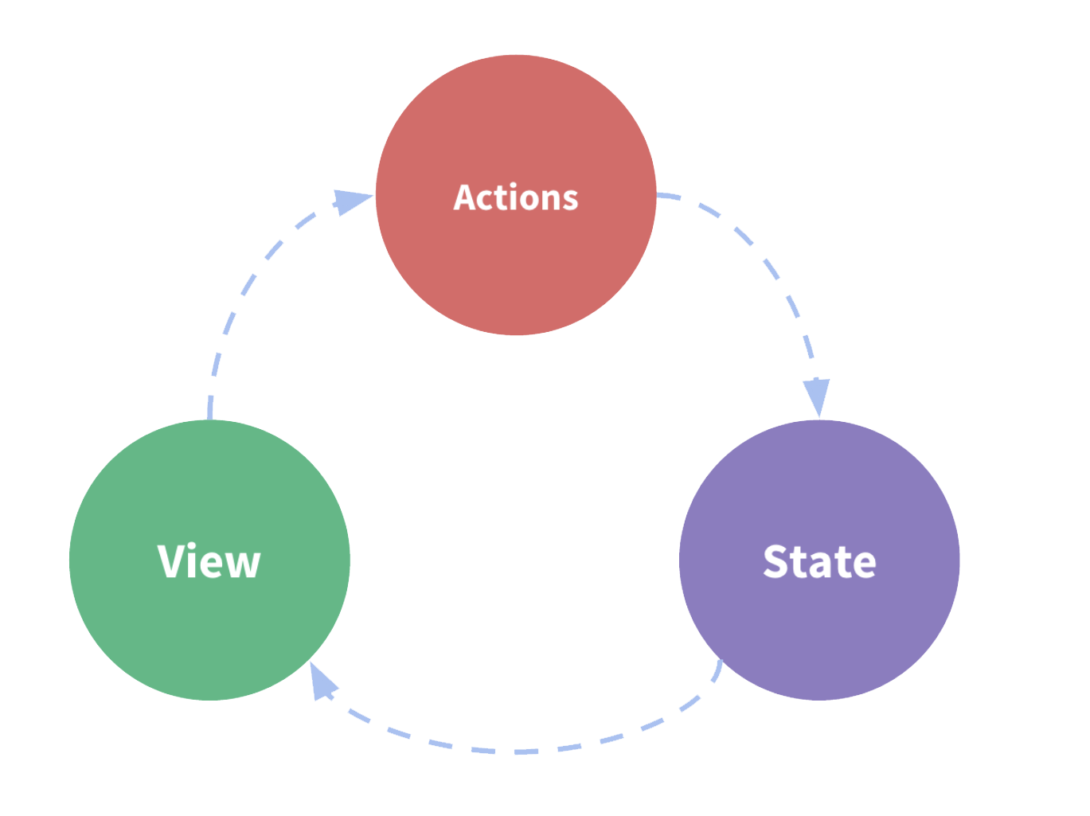
State Management
Notes:
It is a self-contained app with the following parts:
The state, the source of truth that drives our app;
The view, a declarative description of the UI based on the current state
The actions, the events that occur in the app based on user input, and trigger updates in the state
This is a small example of "one-way data flow":
State describes the condition of the app at a specific point in time
The UI is rendered based on that state
When something happens (such as a user clicking a button), the state is updated based on what occurred
The UI re-renders based on the new state

Slide 56
Redux Terminologies
Action
Action Creators
Reducers
Store
Dispatch
Selectors
Notes:
Redux is a pattern and library for managing and updating application state, using events called "actions". It serves as a centralized store for state that needs to be used across your entire application, with rules ensuring that the state can only be updated in a predictable fashion.
Redux helps you manage "global" state - state that is needed across many parts of your application.
The patterns and tools provided by Redux make it easier to understand when, where, why, and how the state in your application is being updated, and how your application logic will behave when those changes occur. Redux guides you towards writing code that is predictable and testable, which helps give you confidence that your application will work as expected.

Slide 57
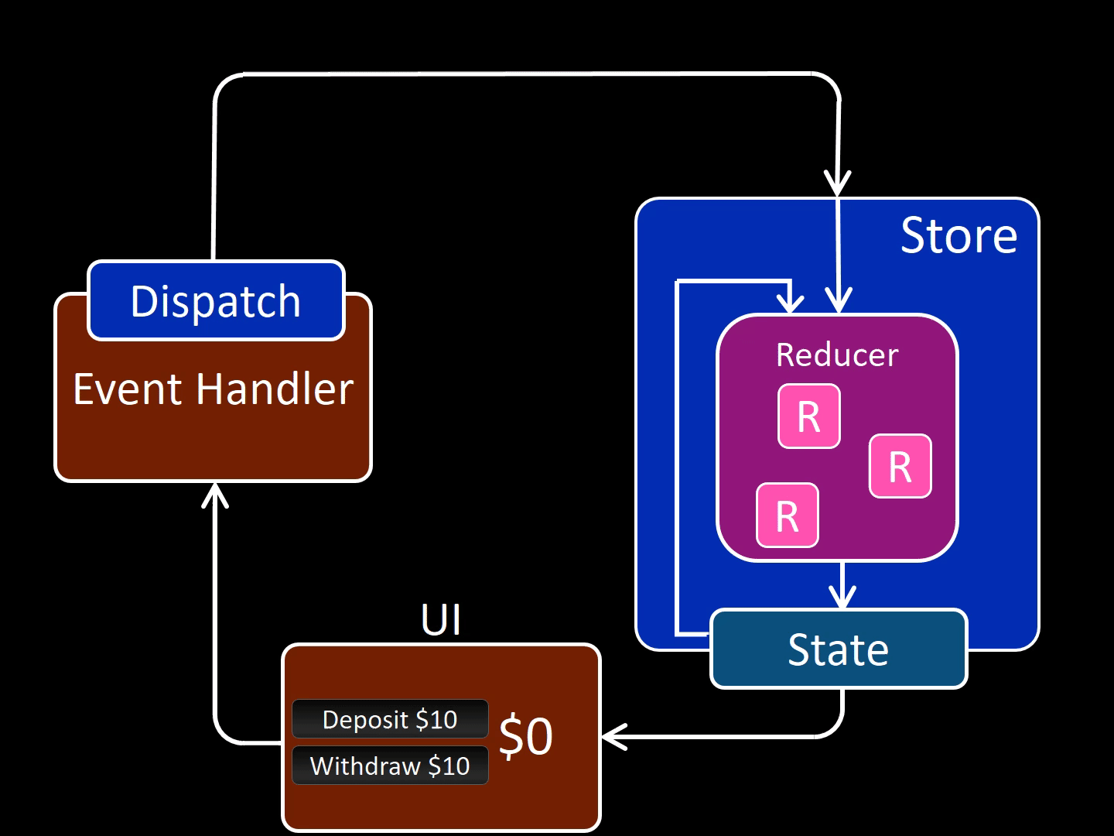
Redux Application Data Flow
Notes:
It is a self-contained app with the following parts:
The state, the source of truth that drives our app;
The view, a declarative description of the UI based on the current state
The actions, the events that occur in the app based on user input, and trigger updates in the state
This is a small example of "one-way data flow":
State describes the condition of the app at a specific point in time
The UI is rendered based on that state
When something happens (such as a user clicking a button), the state is updated based on what occurred
The UI re-renders based on the new state

Slide 58
Redux Application Data Flow
State describes the condition of the app at a point in time, and UI renders based on that state
When something happens in the app:
The UI dispatches an action
The store runs the reducers, and the state is updated based on what occurred
The store notifies the UI that the state has changed
The UI re-renders based on the new state

Slide 59
Redux
Problem Statement : Create a Custom Increment App using Redux .
Notes:
Redux is a pattern and library for managing and updating application state, using events called "actions". It serves as a centralized store for state that needs to be used across your entire application, with rules ensuring that the state can only be updated in a predictable fashion.
Redux helps you manage "global" state - state that is needed across many parts of your application.
The patterns and tools provided by Redux make it easier to understand when, where, why, and how the state in your application is being updated, and how your application logic will behave when those changes occur. Redux guides you towards writing code that is predictable and testable, which helps give you confidence that your application will work as expected.

Slide 60
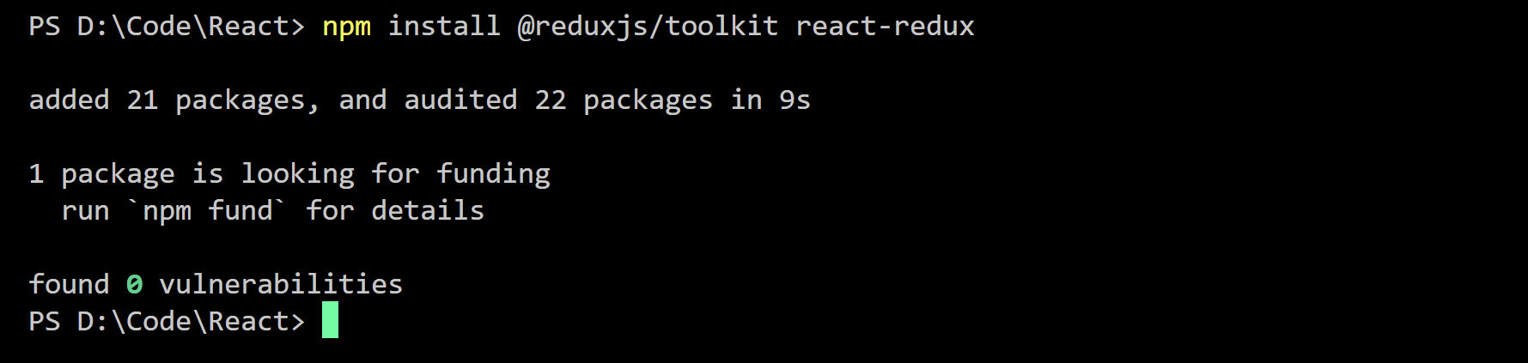
Redux Toolkit
Redux Toolkit is a set of tools that helps simplify Redux development.
Includes utilities for creating and managing Redux stores, as well as for writing Redux actions and reducers.
Initialization
Notes:
Redux is a pattern and library for managing and updating application state, using events called "actions". It serves as a centralized store for state that needs to be used across your entire application, with rules ensuring that the state can only be updated in a predictable fashion.
Redux helps you manage "global" state - state that is needed across many parts of your application.
The patterns and tools provided by Redux make it easier to understand when, where, why, and how the state in your application is being updated, and how your application logic will behave when those changes occur. Redux guides you towards writing code that is predictable and testable, which helps give you confidence that your application will work as expected.

Slide 61
Redux Toolkit
Create a Redux store with configureStore
- configureStore accepts a reducer function as a named argument
- configureStore automatically sets up the store with good default settings
Provide the Redux store to the React application components
- Put a React-Redux <Provider> component around your <App />
- Pass the Redux store as <Provider store={store}>
Notes:
Redux is a pattern and library for managing and updating application state, using events called "actions". It serves as a centralized store for state that needs to be used across your entire application, with rules ensuring that the state can only be updated in a predictable fashion.
Redux helps you manage "global" state - state that is needed across many parts of your application.
The patterns and tools provided by Redux make it easier to understand when, where, why, and how the state in your application is being updated, and how your application logic will behave when those changes occur. Redux guides you towards writing code that is predictable and testable, which helps give you confidence that your application will work as expected.

Slide 62
Redux Toolkit
Create a Redux "slice" reducer with createSlice
- Call createSlice with a string name, an initial state, and named reducer functions
- Reducer functions may "mutate" the state using Immer
- Export the generated slice reducer and action creators
Use the React-Redux useSelector/useDispatch hooks in React components
- Read data from the store with the useSelector hook
- Get the dispatch function with the useDispatch hook, and dispatch actions as needed
Notes:
Redux is a pattern and library for managing and updating application state, using events called "actions". It serves as a centralized store for state that needs to be used across your entire application, with rules ensuring that the state can only be updated in a predictable fashion.
Redux helps you manage "global" state - state that is needed across many parts of your application.
The patterns and tools provided by Redux make it easier to understand when, where, why, and how the state in your application is being updated, and how your application logic will behave when those changes occur. Redux guides you towards writing code that is predictable and testable, which helps give you confidence that your application will work as expected.

Slide 63
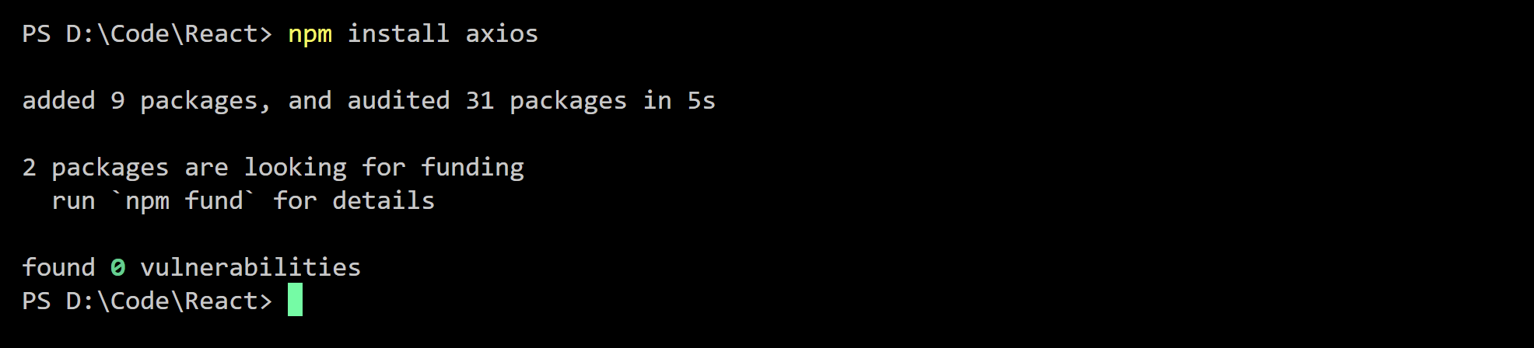

Axios
HTTP Client Library
Promise Based
Allows to make requests to a given endpoint.
Installation :

Slide 64
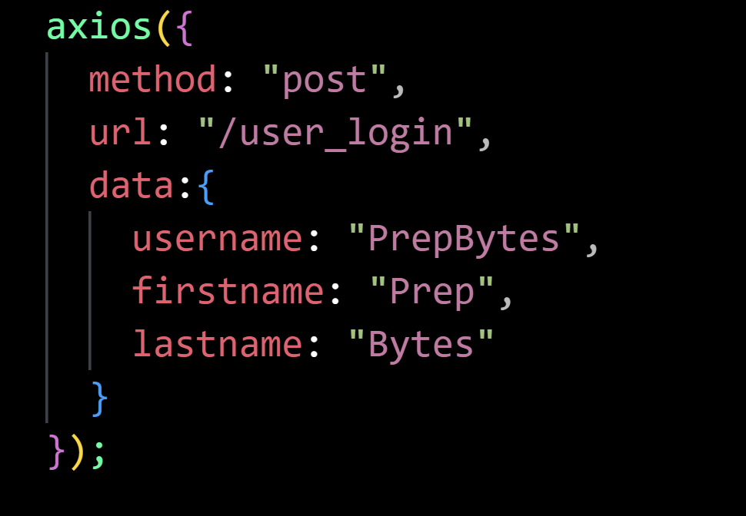
Sending HTTP Request
axios() Function
Configuration Options
- method: The HTTP method through which the request should be sent in
- url: The server's URL to which the request must be sent to
- data: The data specified with this option is sent in the body of the HTTP request in Axios POST requests, PUT, and PATCH.

Slide 65
Axios Request Methods
axios.request(config)
axios.get(url[, config])
axios.delete(url[, config])
axios.head(url[, config])
axios.options(url[, config])
axios.post(url[, data[, config]])
axios.put(url[, data[, config]])
axios.patch(url[, data[, config]])

Slide 66
Axios Response Objects
data - the payload returned from the server
status - the HTTP code returned from the server
statusText - the HTTP status message returned by the server
headers - headers sent by the server
config - the original request configuration
request - the request object

Slide 67
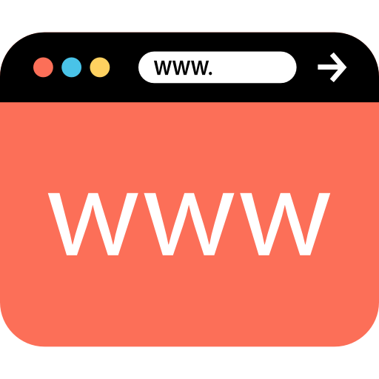

Axios Post Request
axios.post(“url”,Data Objects)

Slide 68

Axios Get Request
axios.get(‘url’).then(function(response){
console.log.(responses )
})

Slide 69
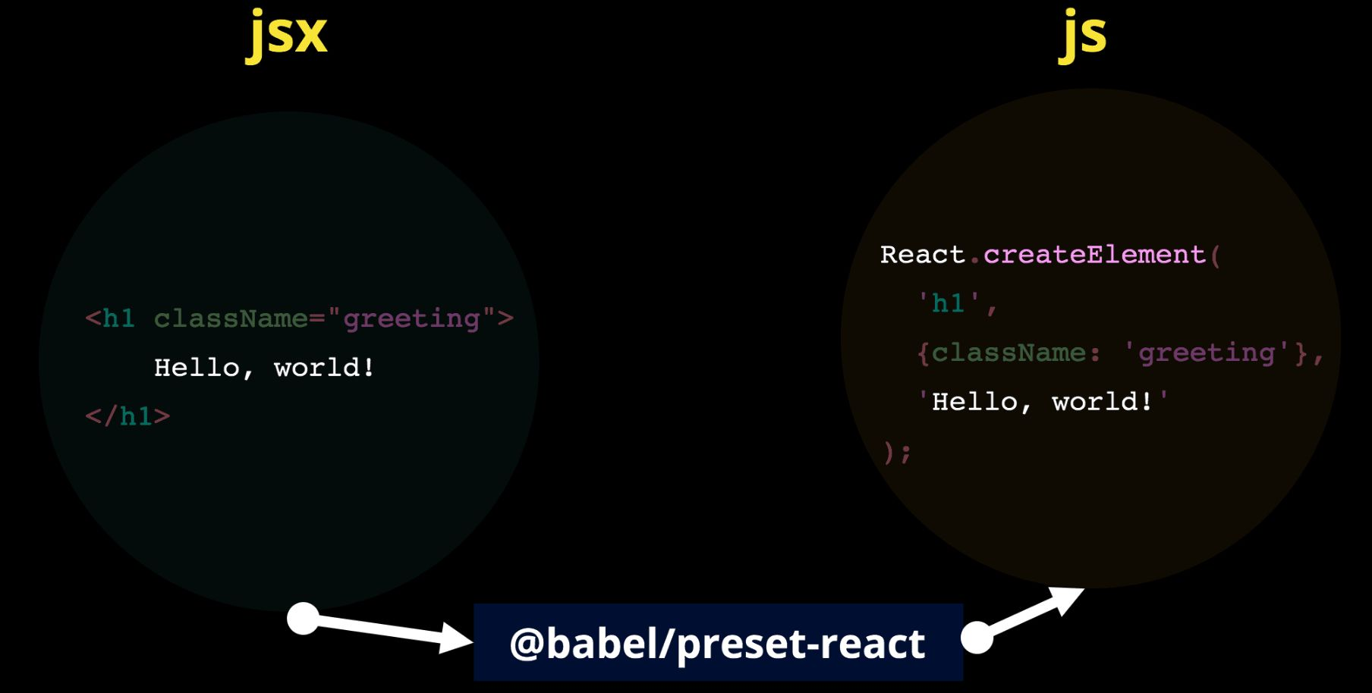
Babel

Slide 70
Babel
@babel/core
@babel/preset-react
@babel/preset-env
Babel-loader

Slide 71
Webpack
Index.html
Copy
Index.html
Includes
Includes
JavaScript Files
(in ES6 !)
Bundle Files
Bundle
Transpile
Source
Webpack
Output

Slide 72
Webpack
webpack
webpack-dev-server
html-webpack-plugin

